Slide 1
Segmented Pricing
Pricing Strategies
2025
Jean-Pierre Dubé
© Copyright 2025

Slide 2
Overview of segmented pricing
Pricing structures that raise profits by segmenting on price to capture value from customers with different tastes
We will look at theory and examples
Targeted (Personalized) Pricing
Product Line Pricing Strategy as indirect segmented pricing
Product Line Pricing tactics & cannibalization

Slide 3
Recall: Optimal Uniform Price Charge customers same price for same product
Price
P^{A}
Money left
on table
P^{B}
Optimal uniform price
Profits
P^{C}
Marginal
cost
Segment A
Segment B
Segment C
Quantity
Unserved segment

Slide 4
Targeted Pricing Suppose we could identify customers/segments
Price
P^{A}
Targeted Price to segment A
P^{B}
Targeted Price to segment B
Profits
P^{C}
Targeted Price to segment C
Marginal
cost
Segment A
Segment B
Segment C
Quantity
Incremental
Profits
From Targeting
(Growth!!!)

Slide 5


Scalable online price targeting Example: Ziprecruiter.com
5
Recall our online recruiting B2B pricing experiment
Originally charging $99 per month
In August 2015, we tested 10 price levels in an experiment
We determined that $249 would be much more profitable
In November 2015, we also tested a personalized pricing strategy using AI
Source: Dubé and Misra (2023)

Slide 6
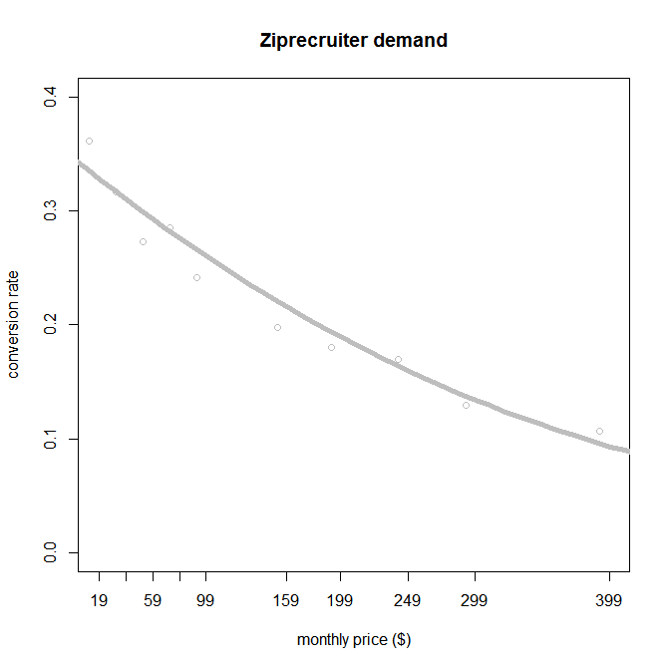
Ziprecruiter Demand
Customer $X_{A}$
Customer $X_{B}$
Customer $X_{C}$
Are there feature variables, X, that predict an individual customer’s demand before she hits the paywall?
Customer $X_{D}$

Slide 7
Monetizing Customer Data
Customer data Ziprecruiter observes at registration stage
Company/Job Variable Names
Job state
Company type
Has commissions
Company declared job slots needed
Job total benefits
Employment type
Resume required
Job medical benefit
Job vision benefit
Job life insurance benefit
Job category
Can Ziprecruiter monetize these data?

Slide 8

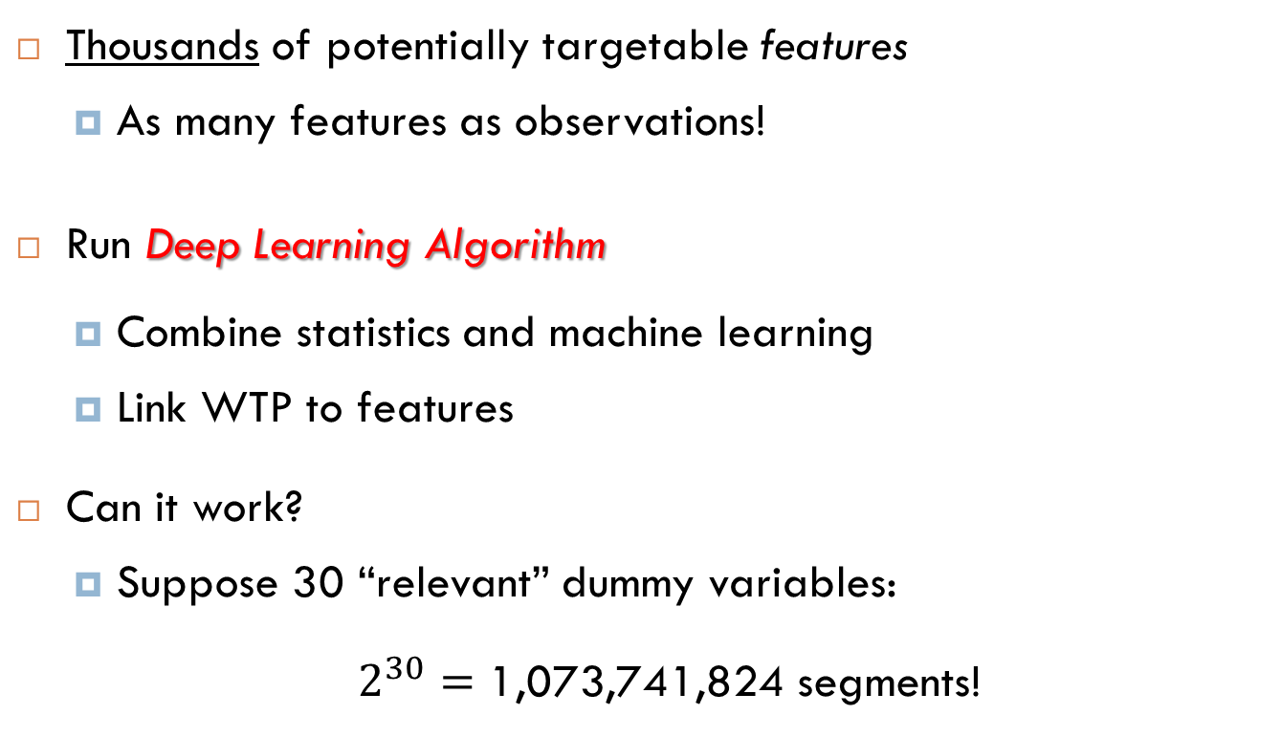
Scalable Personalized Pricing Targeting as a Big Data problem
Thousands of potentially targetable features
As many features as observations!
Run Deep Learning Algorithm
Combine statistics and machine learning
Link WTP to features
Can it work?
Suppose 30 “relevant” dummy variables:
$2^{30}=\text{1,073,741,824}$ segments!
A.I.
Source: Dubé and Misra (2023)

Slide 9
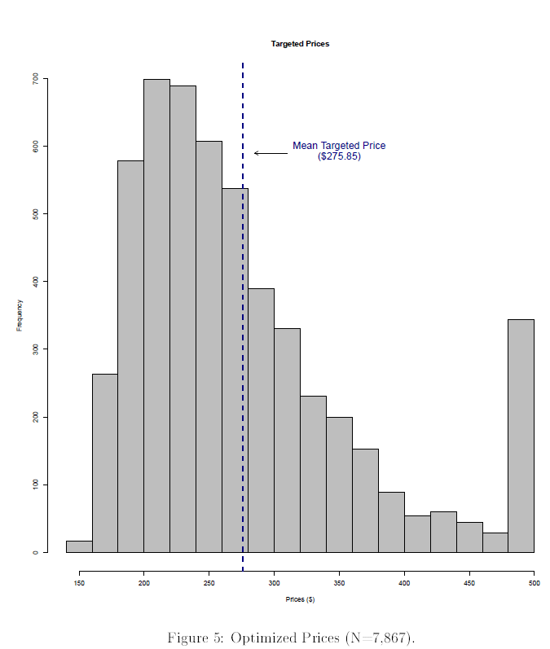
Scalable Personalized Pricing Simulated Personalized Prices for August 2015 training sample
Cap at $499 to prevent customer
backlash or “sticker shock”
apply inverse-elasticity rule for each customer
Distribution of Personalized Prices (N= 7,867)
Source: Dubé and Misra (2023)
Notes:
Combination of analytics and managerial reasoning

Slide 10

Scalable Personalized Pricing Projected Revenues
10
Pricing | Projected Profit Per Lead
Base ($99) | $25
Uniform ($249) | $40
Targeted | $44
Source: Dubé and Misra (2023)

Slide 11

Scalable Personalized Pricing Validation
11
Nov 2015: Implement a 3-bin experiment
5,315 new “starter” firms
Control pricing – $99 (25%)
Uniform pricing – $249 (25%)
Targeted pricing (50%)
Run and evaluate.
Source: Dubé and Misra (2023)

Slide 12
Scalable Personalized Pricing Validation
Pricing | Projected Profit Per Lead | Realized Profit Per Lead
Base ($99) | $25 | $23
Uniform ($249) | $40 | $38
Targeted | $44 | $42
65% Rev ⬆
83% Rev ⬆
When we account for statistical error, our results fall within our predictions back in September 2015
A.I. algorithm seems to work well!!!
Source: Dubé and Misra (2023)

Slide 13


Scalable Personalized Pricing Evaluation
Recall:
Optimization increased monthly profits by 65%
Approximately $70 million in incremental
Personalization could have pushed it over $80 million

Slide 14
Challenges with Targeted Pricing Is it Legal?
U.S. law (E.U. is stricter on race, nationality & geography):
“In certain limited circumstances, price discrimination might feature as an aspect of an exclusionary strategy meant to enhance or protect market power. Intervention should be limited to preventing these exclusionary abuses… Absent accompanying unfair or deceptive conduct, personalized pricing alone does not raise any of these concerns, and therefore provides no basis for intervention.” (FTC, 2018)
Disparate Treatment prohibited in housing, credit, employment, public accommodations, & voting based on protected classes
sex, race/color, religion/creed, nationality, sexual orientation/gender identity, disability status, familial status, veteran status, genetic info
The Pink Tax Repeal Act (HR 2048): prohibits product manufacturers or service providers from selling substantially similar products at different prices based on gender… If, for example, only difference between 2 products is color, they are substantially similar. (pending in Congress)
See also
Katzman V. Victoria's Secret Catalogue 923 F. Supp. 580 (1996)
“Battle of the Prices: Is It Ever Fair to Charge One Sex More?” The Atlantic, 20144

Slide 15
Challenges with Targeted Pricing Is it Legal? Chinese law is stricter
Price Law of the People's Republic of China (Dec. 29, 1997)
“Operators shall not engage in the following unfair pricing practices:
5. When providing the same goods or services, practicing price discrimination against other operators with the same trading conditions;”
Regulations of Shenzhen Special Economic Zone on Promoting the Artificial Intelligence Industry (March 8, 2024)
“Any organization or individual engaged in AI research or application shall not conduct any of the following acts:
4. Any organization or individual shall not discriminate against users based on race, gender, nationality, ethnic group or religious beliefs;
5. Any organization or individual shall not resort to any acts that harms consumers’ rights and interests, such as price discrimination and consumption fraud, based on user’s habits, preferences or ability to pay;”

Slide 16

Challenges with Targeted Pricing Fairness
4
Is targeted pricing fair?

Slide 17

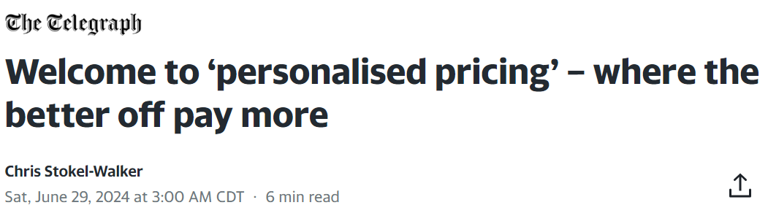

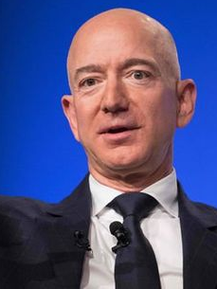
Challenges with Targeted Pricing Fairness & Public Relations Concerns
Firms may avoid targeting for PR reasons
"We've never tested and we never will test prices based on customer demographics”
Jeff Bezos, CEO, Amazon
Also see extra slides on other challenges with targeted pricing

Slide 18

Challenges with targeted pricing Fairness & International Segmentation
“The U.S. subsidizes the worldwide pharmaceutical market. One reason is U.S. prices are higher than elsewhere. If each drug had a single international price across the highest-income OECD countries, and total pharmaceutical firm profits were held fixed, then U.S. prices would fall by half and every other country’s prices would increase (by 28 to 300%). International prices would maintain firms’ R&D incentives and more equitably share the costs of pharmaceutical research.”
Ho & Pakes (2024), National Bureau of Economic Research

Slide 19
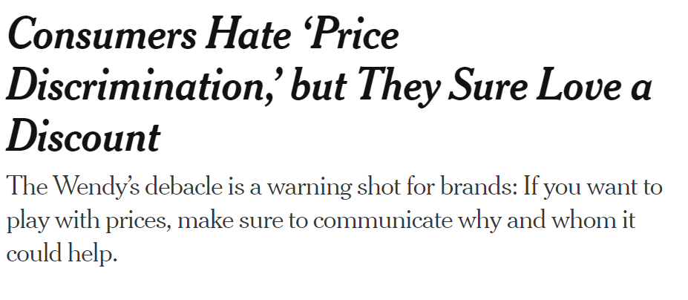
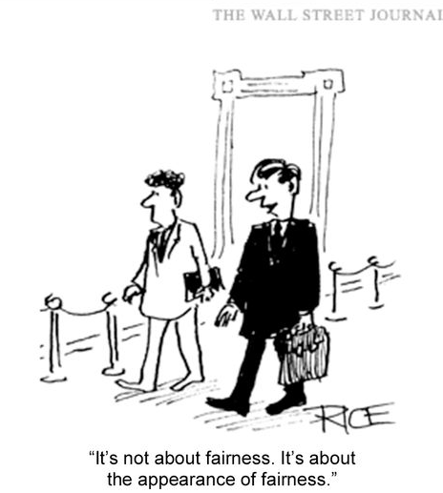
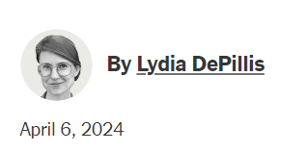
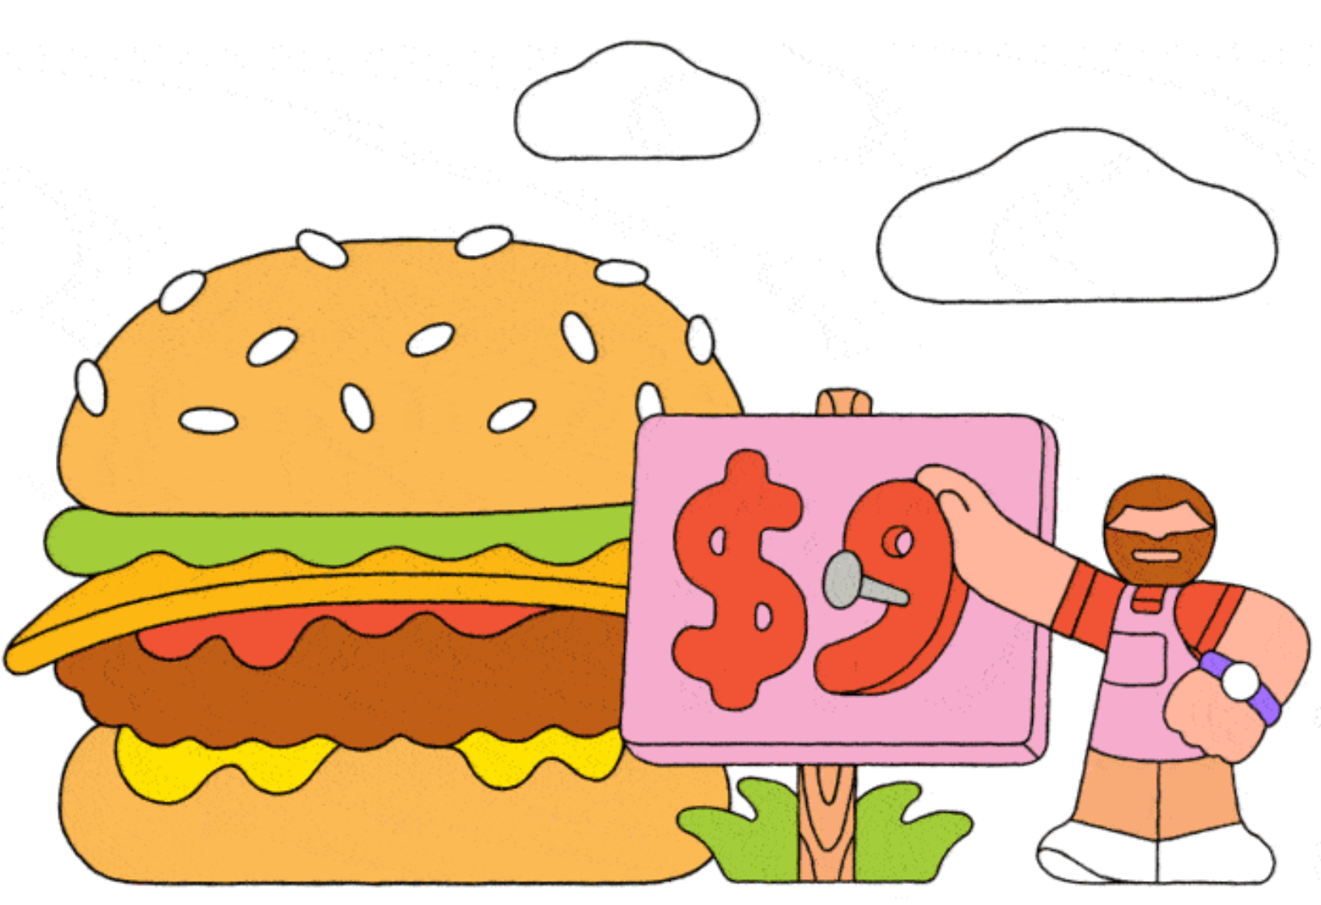
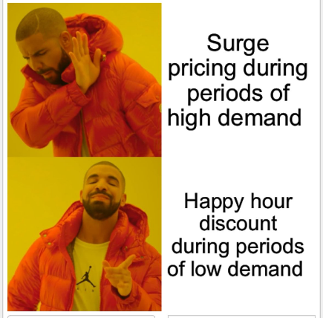
Of course, what is “fair”?

Slide 20
Degrees of Price Segmentation Product Line Pricing or Indirect Pricing
If Targeting is tricky in your product market(s)…
Suppose you launch different versions of your product to charge different prices to different segments.
E.g., high quality for high WTP segments and low quality for low WTP segments…
use quality as an indirect “fence” to segment customers

Slide 21

Indirect vs Direct Price Segmentation
Targeting
Product Line Pricing
“versioning”
Price
(low)
Price
(high)
Price
(medium)
Product 1
Good
Product 2
Better
Product 3
Best
Low margin
Medium margin
High margin
Offer everyone same set of products
Let buyers self-select

Slide 22
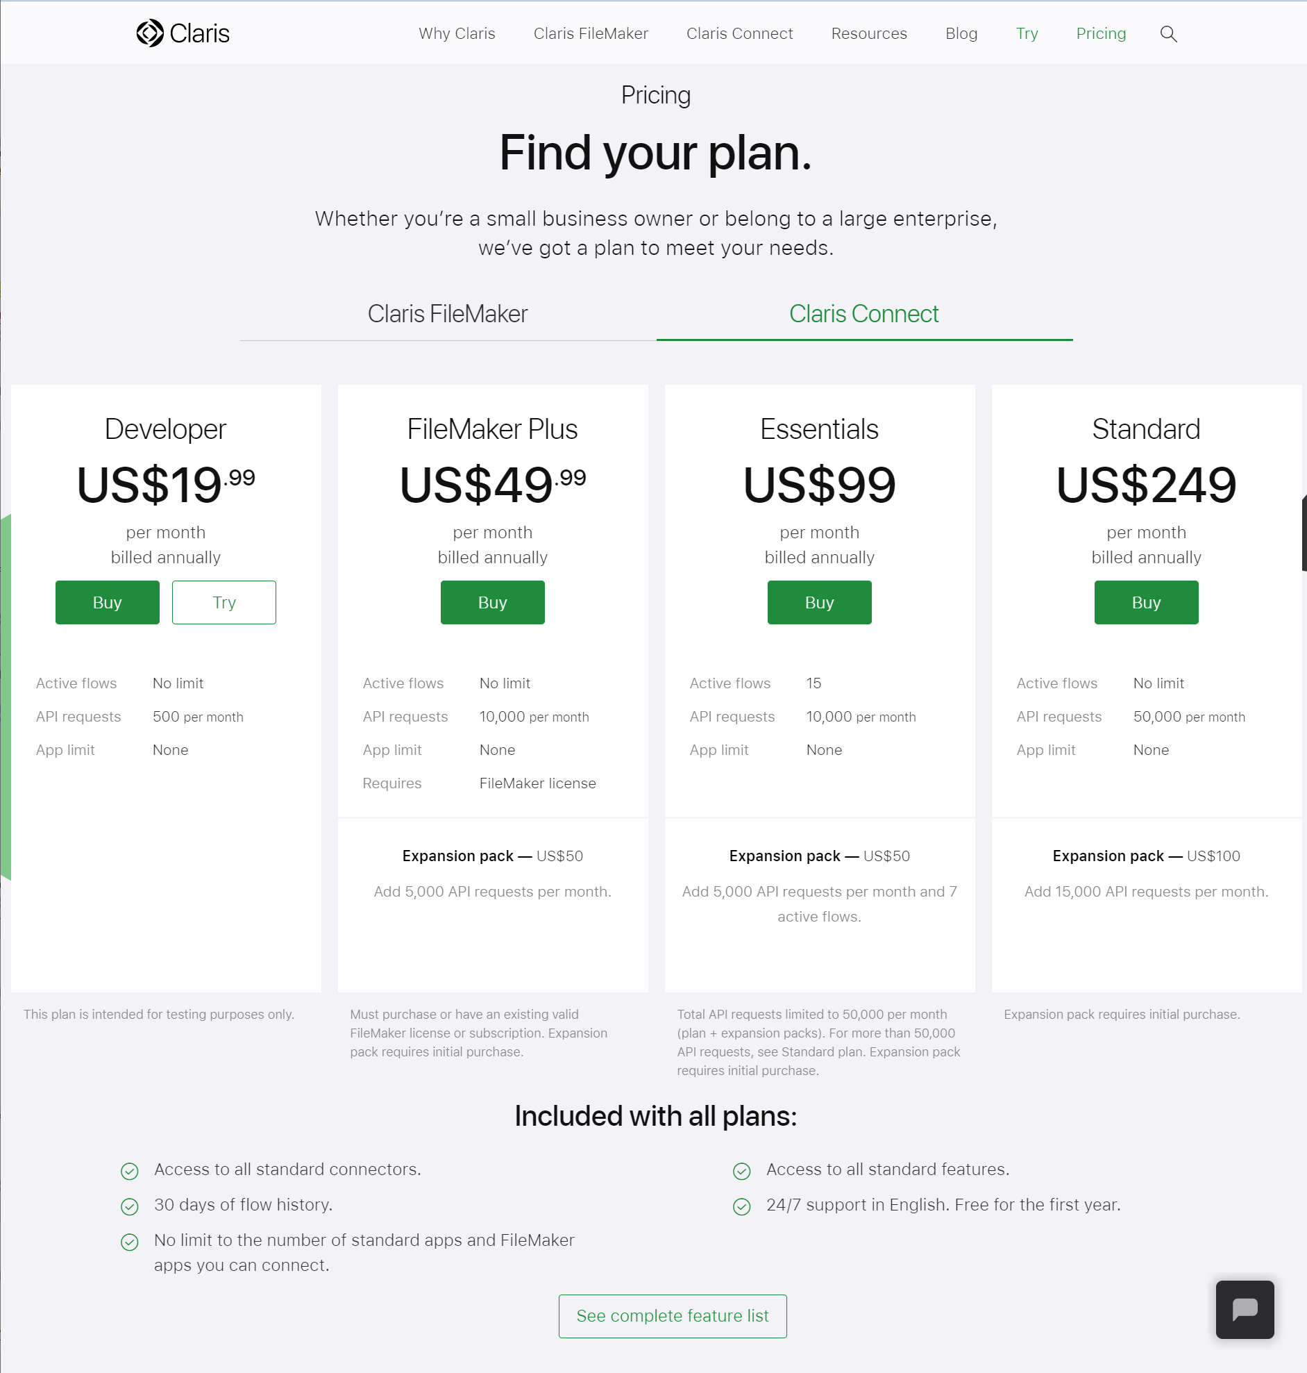
Product Line Pricing Strategy is common in high-tech industries: SaaS
Platform to consolidate workflow in a company across applications (e.g., automation of processes that need to connect applications)
Also have product for app development.
https://www.claris.com/pricing/connect.html

Slide 23
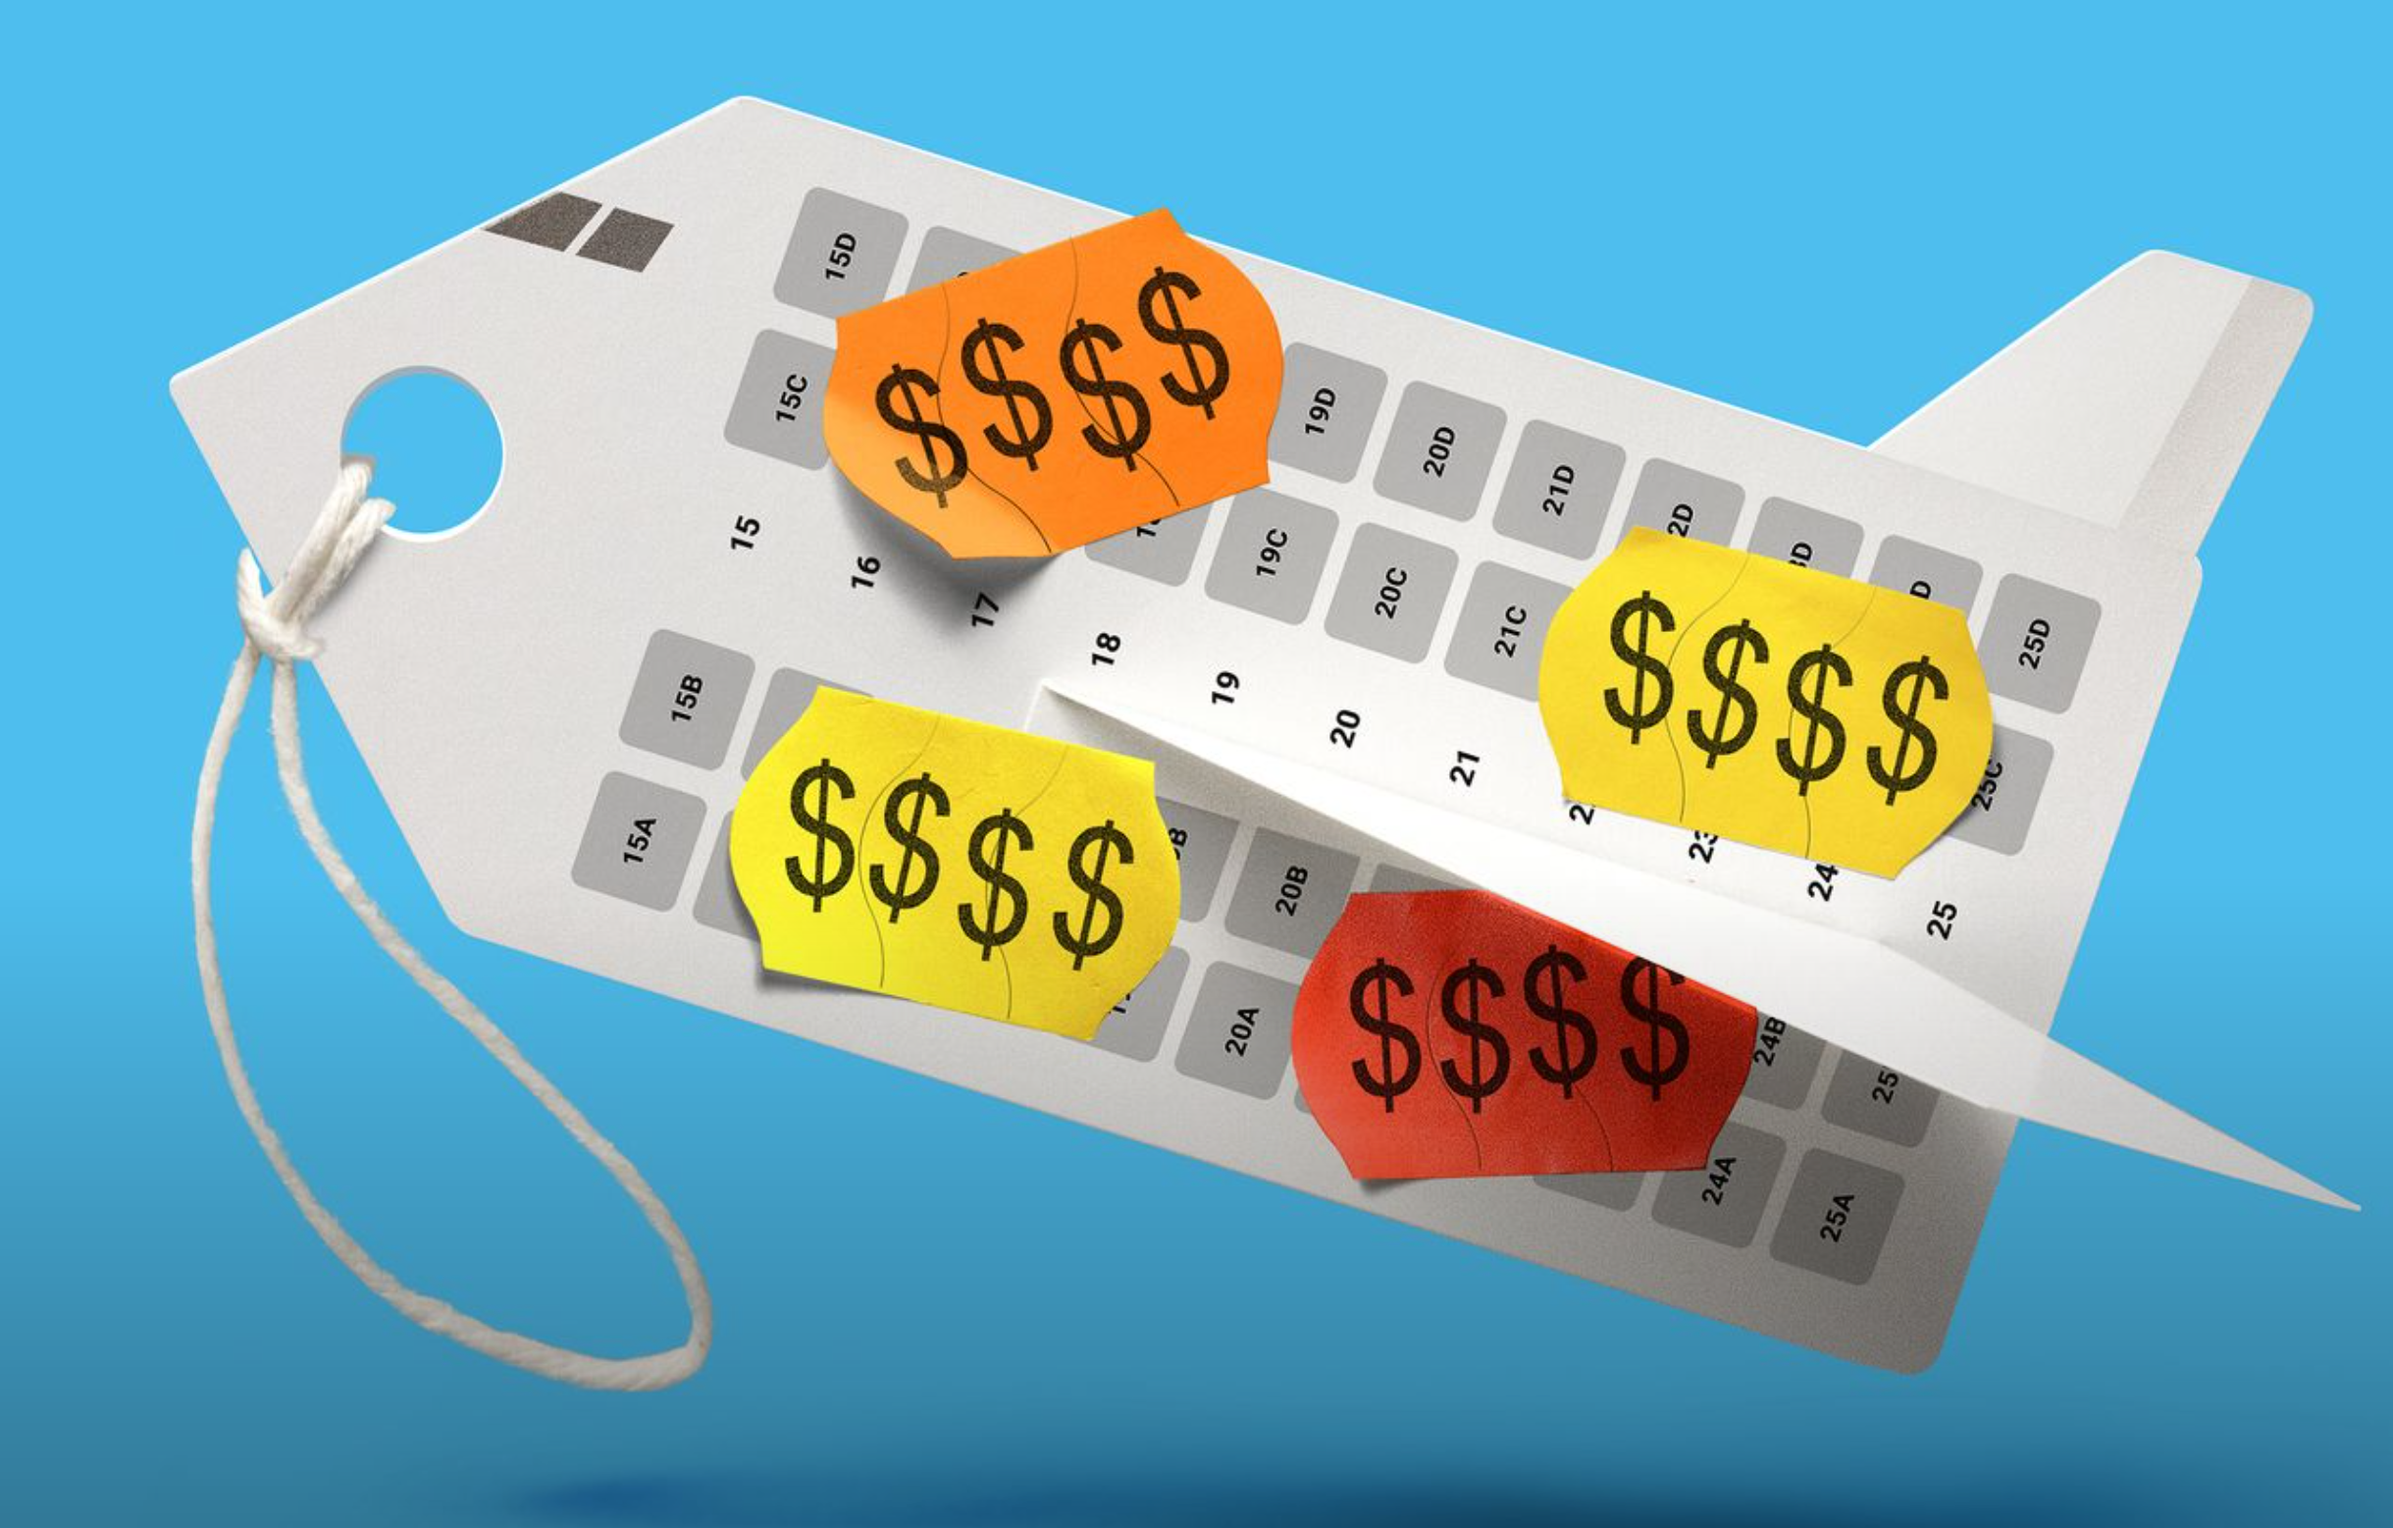
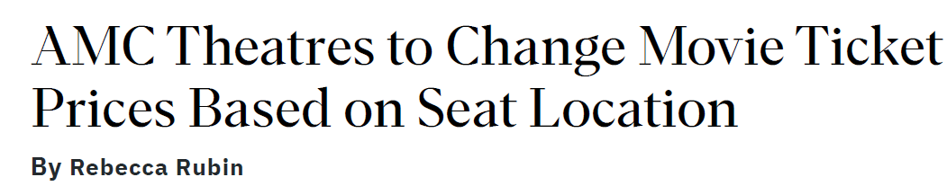

Product Line Pricing Strategy is common in Consumer Industries
Want to Know Where You’re Sitting on Your Next Flight? It’ll Cost You
The largest U.S. airlines aren’t shy about fees that let you choose regular old seats; European flights can be even tougher
By Dawn Gilbertson, Wall Street Journal, April 16, 2024
“American was recently asking an extra $44 to $52 one way for a standard seat near the front of the plane for a flight from Dallas to New York this week and $29 to $35 for the same flight in June.”

Slide 24
Product Line Pricing Strategy Separation via Indirect Pricing
Suppose we manage a product line with several substitute choices.
Customers face a trade-off between quality and price
Goal: segment customers based on what they buy and, hence, what they pay
High WTP selects higher price offer
Low WTP selects lower price offer
Problem: high WTP customers may “trade down” (cannibalization)
Solution: “Sorting Strategies”
Make the low price offer less attractive
Make the high price offer more attractive
Coordination of Price and Product

Slide 25
Product Line Pricing Strategy Separation via Indirect Pricing
Product Line Pricing
“versioning”
What if low prices draw everyone to low-end product?
Product 1
Good
Product 2
Better
Product 3
Best
Low margin
Medium margin
High margin
Offer everyone same set of products
Let buyers self-select

Slide 26
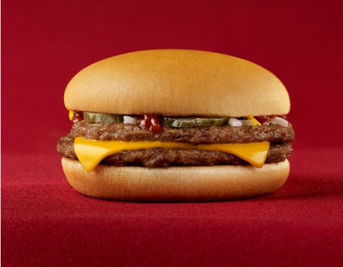
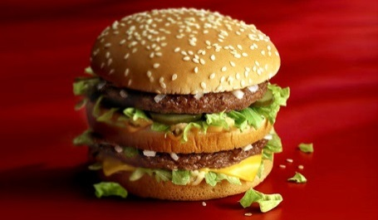
Potential Cannibalization at McDonald’s Example: The McDouble
McDouble: $1.00
Permanent dollar-menu item since 2008
to compete with other Restaurants
“…the McDonald’s McDouble, at 390 Calories, 23g (half a daily serving) of protein, 7% of daily fiber, 20% of daily calcium and iron, etc., is the cheapest, most nutritious, and bountiful food that has ever existed in human history.”
Freakonomics Blog
Big Mac costs about $3.99
Cannibalization concerns?
Differentiation value of Big Mac vs McDouble?
Notes:
DM&M = Dollar Menu and More

Slide 27
Managing a Product Line If trading down occurs, …
Price changes
Lower P of high end offer
Raise P of low end offer
Product Value Changes
Increase attractiveness of high end offer
Decrease attractiveness of low end offer
See “Why Some Companies Make Their Products Worse” Richard Davies, Economist, 9-15-2016
and ”How did Tesla make some of its cars travel further during Hurricane Irma?” The Guardian, 9-17-2017

Slide 28

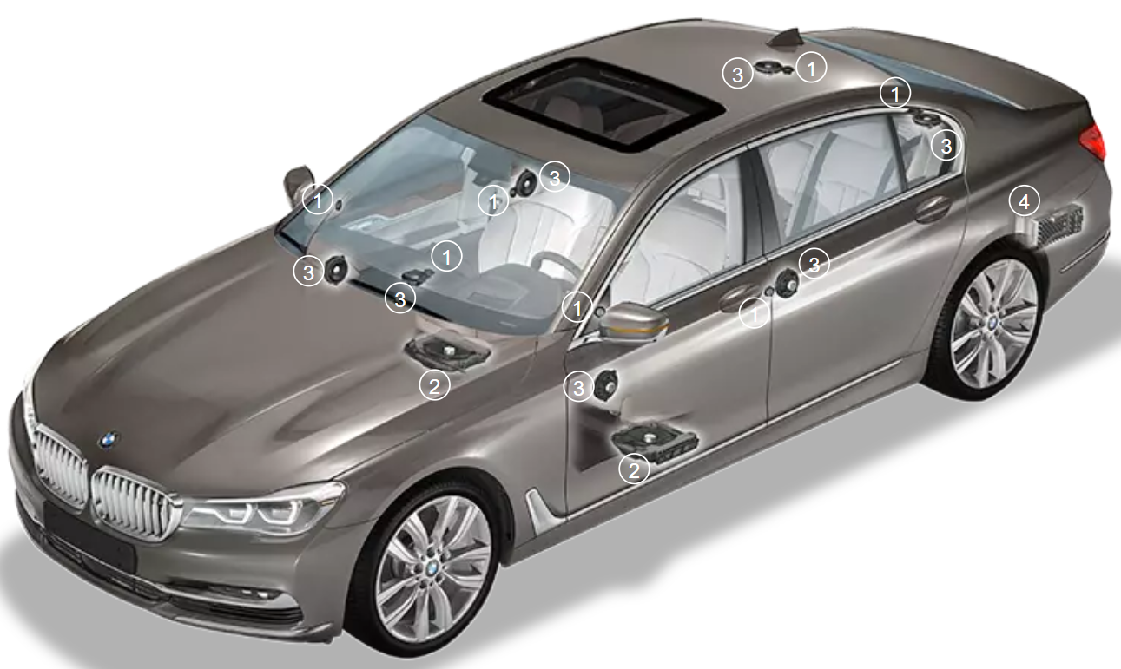
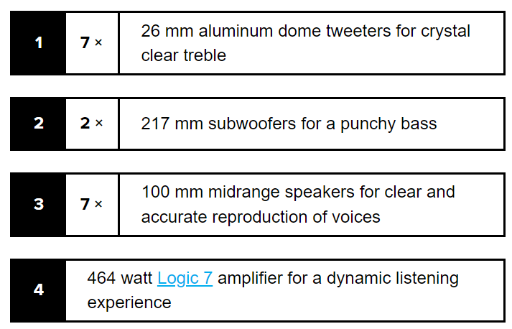
Car Stereo Example Optional stereo upgrade in a BMW i4
Default Audio
10 speakers
205 Watts
Optional Upgrade
multi-channel Harman Kardon surround
17 speakers
464 Watts
Assume: cost of stereo to dealer is $0 (i.e., sunk) to simplify calculations.

Slide 29
Car Stereo Example Optional stereo upgrade in a BMW i4
Value of base car
High consumer Value segment (50%): $75,000
Low consumer Value segment (50%): $55,000
What should we charge for a car?
Marketing
research

Slide 30
Car Stereo Example Optional stereo upgrade in a BMW i4
Value of base car
High consumer Value segment (50%): $75,000
Low consumer Value segment (50%): $55,000
What should we charge for a car?
Marketing
research
 | Upgrade Valuations
Segment | Harman Kardon | Generic
High segment values at … | $ 3,000 | $ 250
Low Segment values at … | $ 500 | $ 100
Marketing
research
Product line:
car with Generic stereo; and
car with Harman Kardon stereo upgrade
1
2

Slide 31
Car Stereo Example Optional stereo upgrade in a BMW i4
Segment | Harman Kardon | Generic
High | $ 3,000 | $ 250
Low | $ 500 | $ 100
Use EVC
${Price}^{Gen}=\$55,100$
${WTP}^{HK} =DV+RV$
$=\text{(\$3,000−\$250)+\$}\text{5}\text{5,100}$
$$=\text{\$57,850}$$
${Price}^{HK}=\$57,850$
Revenue = $55,100 + $57,850 = $112,950 (vs. $110,000) (GROWTH)
Where did the incremental profits come from?
We are indirectly segmenting via product choices
But we do not get the full $78,000 value from the high type

Slide 32
Car Stereo Example Optional stereo upgrade in a BMW i4
Exercise: What is the optimal product line pricing structure if data results for stereo preferences had turned out as follows:
 | Upgrade Valuations
Segment | Harman Kardon | Generic
High segment values at … | $ 3,000 | $ 2,500
Low Segment values at … | $ 500 | $ 100

Slide 33
Car Stereo Example Price Coordination
Car stereo example highlights role of Price coordination in product line pricing
You do not capture all the value on Harman Kardon
Otherwise, Generic stereo cannibalizes Harman Kardon
So product line pricing tactics also need to be coordinated

Slide 34
Product Line Management Coordination of brand manager incentives (HR)
Most firms allocate brand-level decision-making to a brand management team with P&L responsibility only for its brand(s)
What incentives does a brand manager have to coordinate her pricing decisions with substitute goods managed by another manager in the same company?
Ignoring cannibalization can create competition between products or divisions within the same firm!

Slide 35
Take Away
Targeted Pricing is huge opportunity if you sell to very heterogeneous customers. But, it is challenging to implement.
Product Line Pricing is ultimately about coordination and managing customers’ incentives:
serve low-end segments; but
deter high-end segments from trading-down
Uncoordinated tactical pricing ➔ compete with self!
Psychology: Can there be too much variety? See Appendix for Choice Overload.

Slide 36
Appendix: Differential Pricing & Fairness

Slide 37
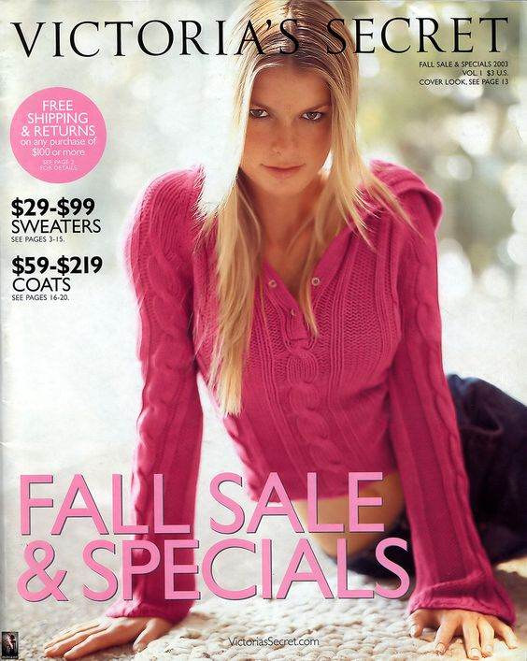
Victoria’s Not-So-Secret Price Discrimination
“Sometimes price discrimination can end up being costly not just to consumers, but also to producers. In 1996 Denise Katzman of New York City sued Victoria’s Secret for gender discrimination and ask for millions of dollars in damages. In alleging gender discrimination, Katzman didn’t object to the catalog’s pages of scantily clad women. Rather, she pointed to the promotional coupon on the catalog’s back page.
The problem? While Ms. Katzman’s catalog offered her a $10 off an order of $74, an almost identical catalog for a male friend offered $25 off the same amount. Was her catalog out of date?
Nope. The folks as Victoria’s Secret were just engaging in a little “naked” price discrimination.”
Source: Goolsbee, Levitt, Syverson, Microecomics, 2014, second edition

Slide 38
Challenges with Targeted Pricing Fairness & Marketing for Good
“...the combination of differential pricing and big data raises concerns that some consumers can be made worse off, and have very little knowledge why.”
“…[differential pricing] transfers value from consumers to shareholders, which generally leads to an increase in inequality and can therefore be inefficient from a utilitarian standpoint.”

Slide 39
How should we define Price Fairness?
Uniform offers versus uniform access/affordability?
Personalized Pricing at Ziprecruiter:
Over 60% customers pay less under personalized pricing (small firms)!
Uniform pricing in US grocery/drug/convenience:
Prices in poor neighborhoods 8% higher than if targeted geographically.
Personalized Pricing & Nutrition:
Low-income consumers have lower WTP for nutritious foods.
Personalized Municipal fines/fees:
Escalating fines/fees increase bankruptcies & evictions in minority neighborhoods.
Pfizer to Sell Vaccines, Drugs at Low Prices to Poorer Countries
…the drugmaker will sell 23 products at not-for-profit prices to 45 countries
Source: Dubé and Misra (2022)
Source: DellaVigna and Gentzkow (2017)
Source: Allcott et al (2019), Dubé (2020)
Source: Dubé (2021), Glenn et al. (2022)
Source: Wall Street Journal, May 26, 2022

Slide 41
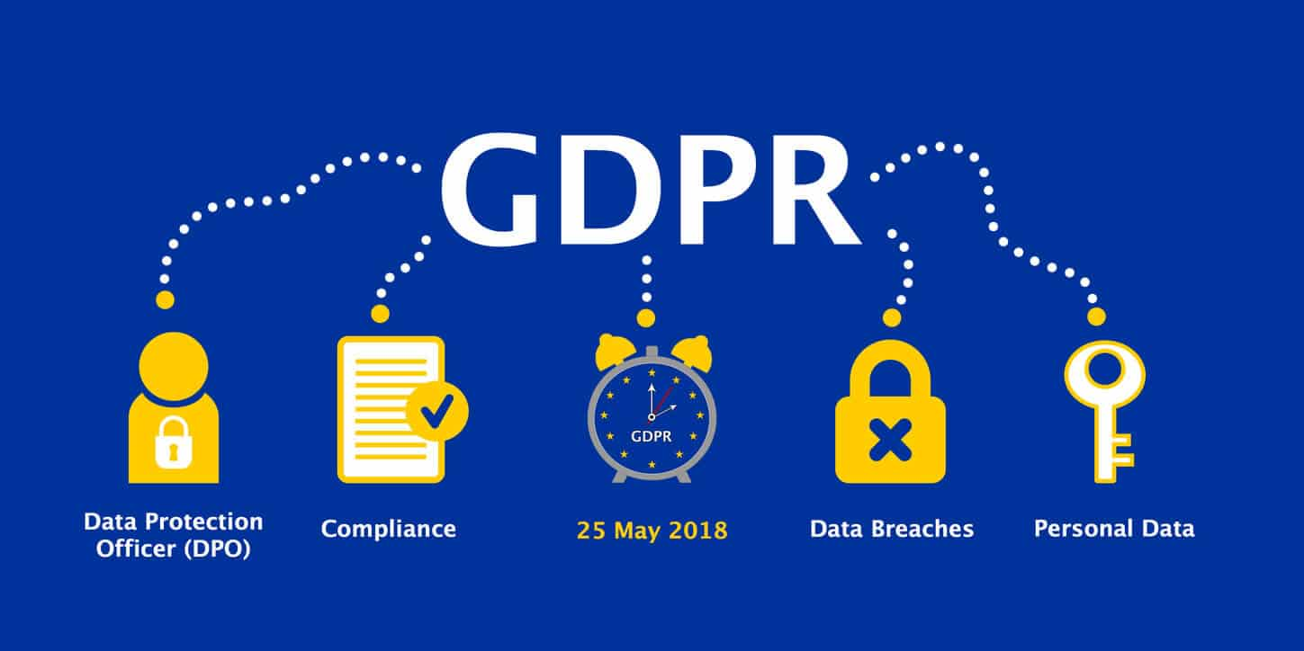
Extra Slides
GDPR and Privacy

Slide 42
GDPR is vague
Requires that use of personal data allows for provision:
“meaningful information about the logic involved, as well as the significance and the envisaged consequences of such processing for the data subject.”
Article 13(2f) and 14(2g) GDPR clarifies:
“The controller should find simple ways to tell the data subject about the rationale behind, or the criteria relied on in reaching the decision. The GDPR requires the controller to provide meaningful information about the logic involved, not necessarily a complex explanation of the algorithms used or disclosure of the full algorithm. The information provided should, however, be sufficiently comprehensive for the data subject to understand the reasons for the decision”

Slide 43
Appendix: Choice Overload

Slide 44
Choice Overload
Economic theory suggested that more items in the product line can improve profits through segmentation…
Is it possible to have too many items on the choice board?
Psychologically, can there be “too much” variety?
Does this adversely affect your pricing power?

Slide 45
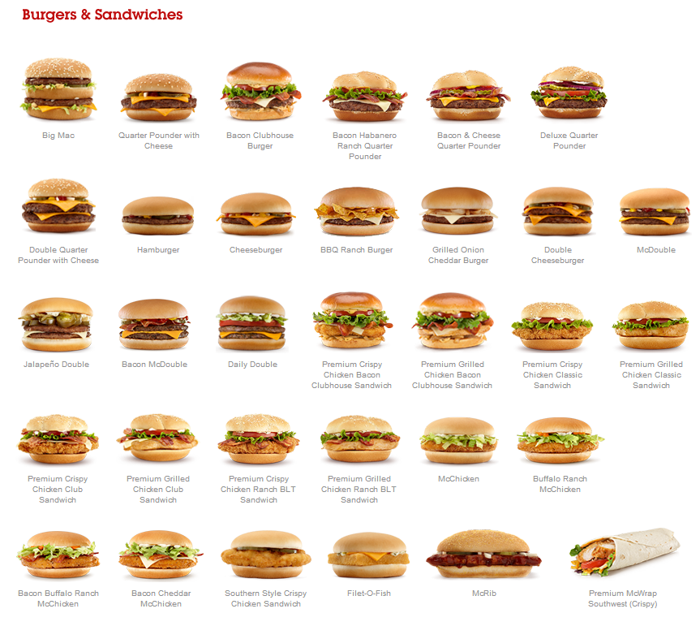
Choice Overload Assortment at McDonalds
segmentation
vs
overload?
“McDonald’s Is Ditching a Bunch Of Menu Items To Better Its Customer Experience,” Business2community, by James Kosur, 1-23-2015

Slide 46
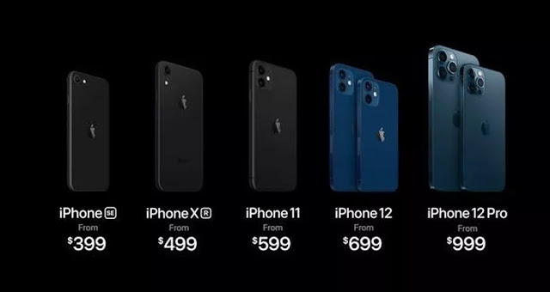
Choice Overload The iPhone 12 product line
“Shopping for an iPhone now requires a magnifying glass for careful inspection of the features—notably the cameras, screen sizes and compatibility with the new 5G cellular networks. It’s important to understand all your choices—what you get and don’t get with each of them, new and old.”
Joanna Stern, “iPhone 12 vs. iPhone 11 vs. iPhone XR vs. iPhone SE: Comparing Apple’s Full Lineup,” WSJ, 10-14-2020

Slide 47
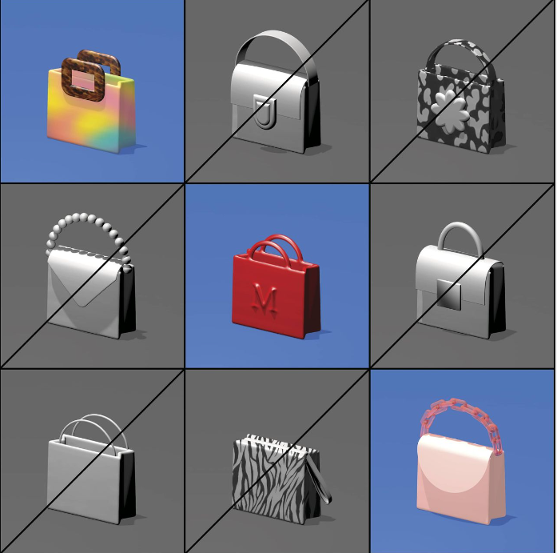
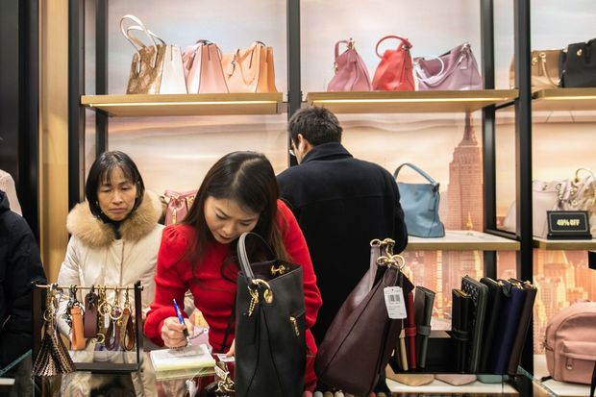
Choice Overload SKU-rationalization in retail
Retailers Cut Back on Choices; ‘We Don’t Need Three Types of Red’
Bed Bath & Beyond, Kohl’s and others cull styles to combat decision paralysis, unclog supply chains and reduce end-of-season markdowns
Suzanne Kapner, WSJ, 11-22-2020
Offering 1,000 handbag models in a rainbow of colors used to lead to end-of-season discounting for Coach, which has halved the number of designs it offers, focused on three popular hues.

Slide 48
Choice Overload Theory
Research in customer psychology finds cases where too many options make customers worse off
Purchase decisions are more complicated
More potential for ex post regret
Customer may decide not to buy
Source: Gourville and Soman (Marketing Science, 2005)

Slide 49
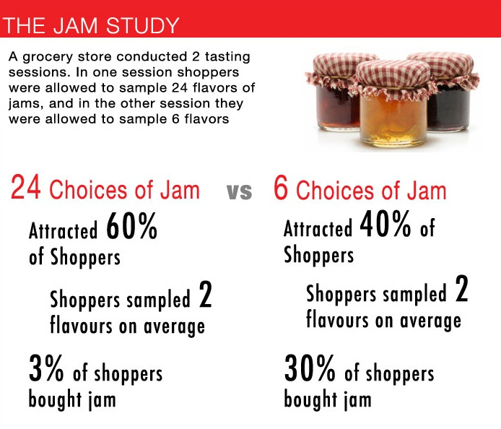
Testing Choice Overload
Source: Iyengar and Lepper (2000)

Slide 50
Testing Choice Overload
Conversion: 1.8%
Conversion: 12%
Source: Iyengar and Lepper (2000)

